Slide 1
Implementing an HPy Backend for Cython: A Performance Benchmark Study
Du Toit Spies
PyConZA 2024
4 October 2024

Slide 2
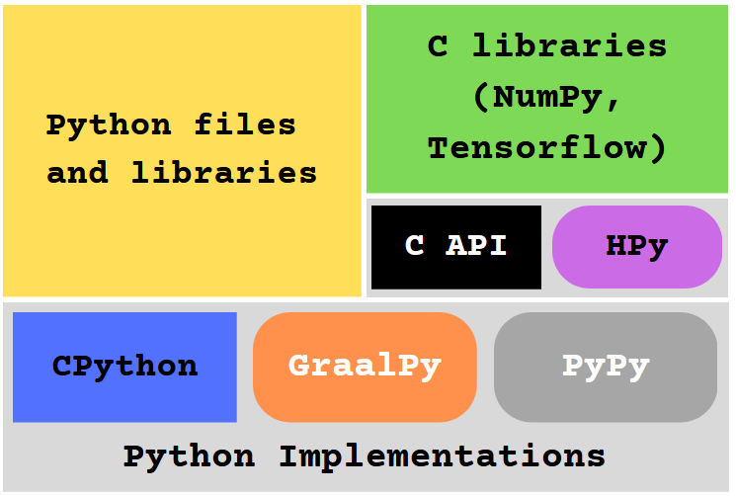
Map of Python

Slide 3
Python Implementations
Programs that can run Python code correctly
Features:
Different memory management strategies
Only Interpreted vs Only Compiled vs Just-In-Time Compilers
Different memory layouts
This research focuses on CPython and GraalPy

Slide 4
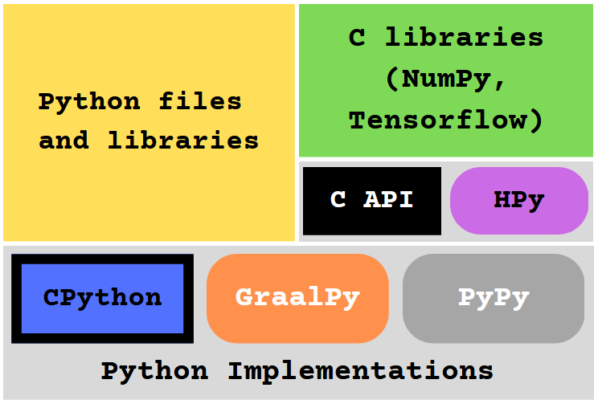
CPython
Reference Implementation
Written in C
Only interpreted
Reference Counting
Exposes the C API
https://www.python.org/

Slide 5
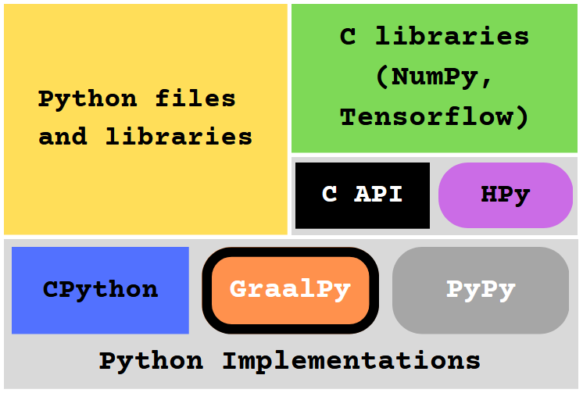
GraalPy
Java-based implementation developed by
Part of larger GraalVM project
JIT compiler
JVM memory management
https://www.graalvm.org/python/​

Slide 6
C API
API that connects C code to the Python interpreter
Used by many popular extensions
Exposed by CPython
Contains many implementation details of CPython
https://docs.python.org/3/c-api/index.html

Slide 7
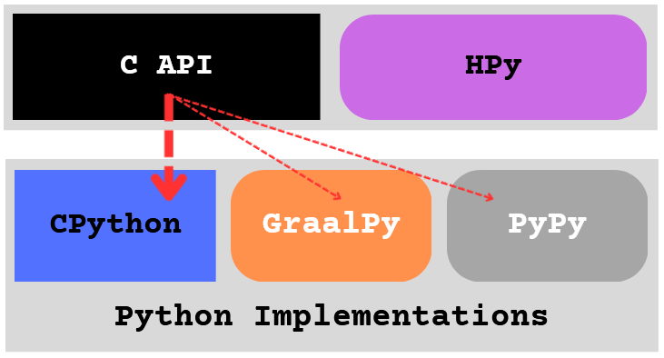
C API

Slide 8
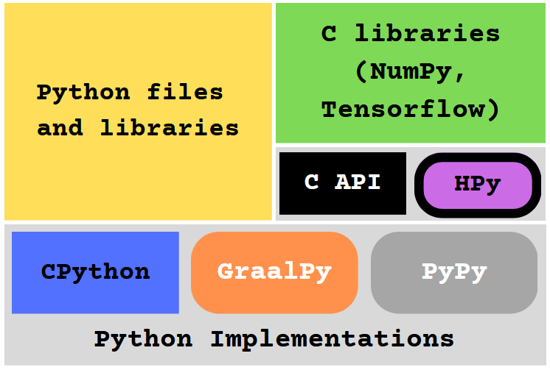
HPy
Alternative to the C API
More generic – not as tied to CPython as the C API
Runs much faster on implementations like GraalPy
Aims for no performance loss on CPython
Not extensively benchmarked yet
hpyproject.com

Slide 9
HPy
ABI – API but for compiled code
HPy libraries can be compiled in 3 different ways:
CPython ABI
Universal ABI
Hybrid ABI

Slide 10
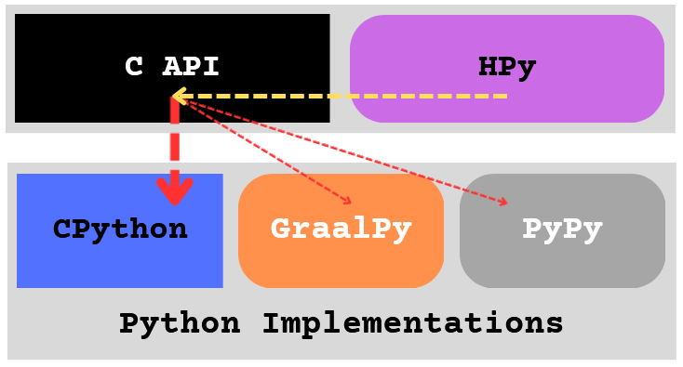
HPy – CPython ABI

Slide 11
HPy – Universal ABI

Slide 12
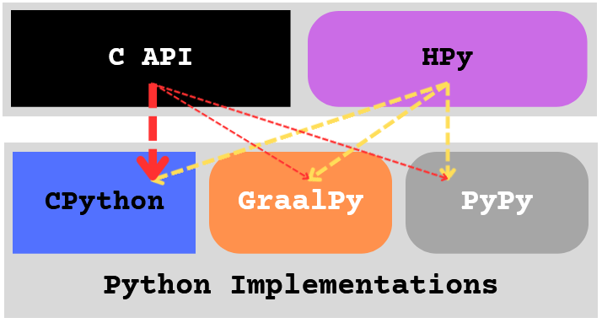
HPy – Hybrid ABI

Slide 13
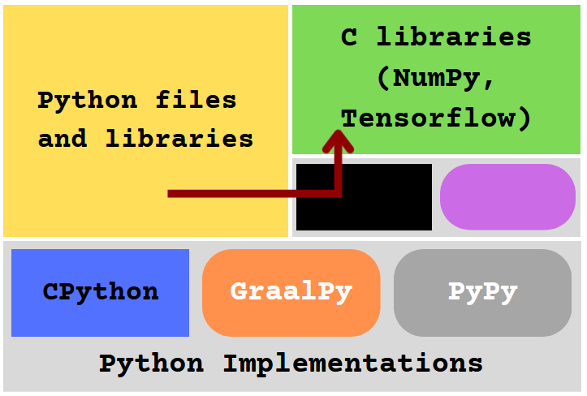
Cython
Compiles Python code to C code
C file can then compile to Python modules and be imported
Can also compile .pyx files – Python files with some C features
Can improve performance by more than 100 times
cython.org

Slide 14
Cython
The C API is used to create libraries from generated C files
Libraries from Cython perform poorly on GraalPy
Cython is incredibly optimised for CPython

Slide 15
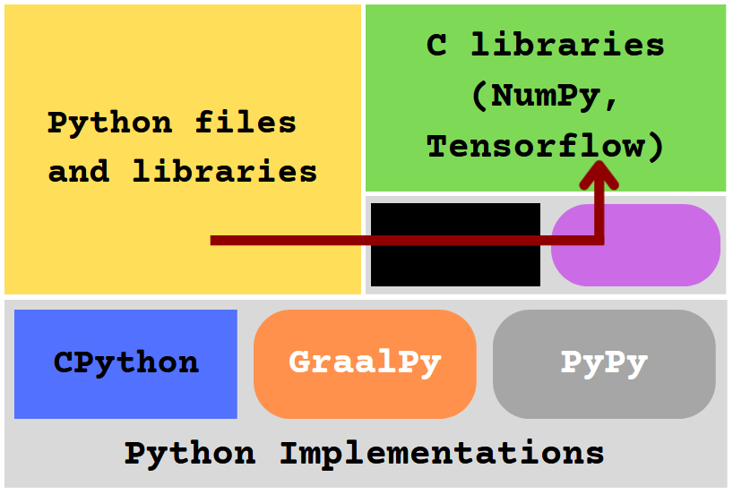
Cython with HPy
This research focused on replacing the C API with HPy in C files generated by Cython
This will allow Cython libraries to run much faster on GraalPy
This will also enable the creation of HPy benchmarks from any Python file

Slide 16
Cython with HPy

Slide 17
Benchmarks
Forloop
single forloop that increments a number 20,000 times
Fibonacci
recursively calculates the 10th Fibonacci number
Float
performs sin, cos, and sqrt calculations on floats, artificial benchmark
Fannkuch
performs array flips and permutations to calculate minimums

Slide 18
Benchmarks
5 Benchmark Configurations Legend
CPython with C API
CPython with HPy CPython ABI
CPython with HPy Hybrid ABI
GraalPy with C API
GraalPy with HPy Hybrid ABI

Slide 19
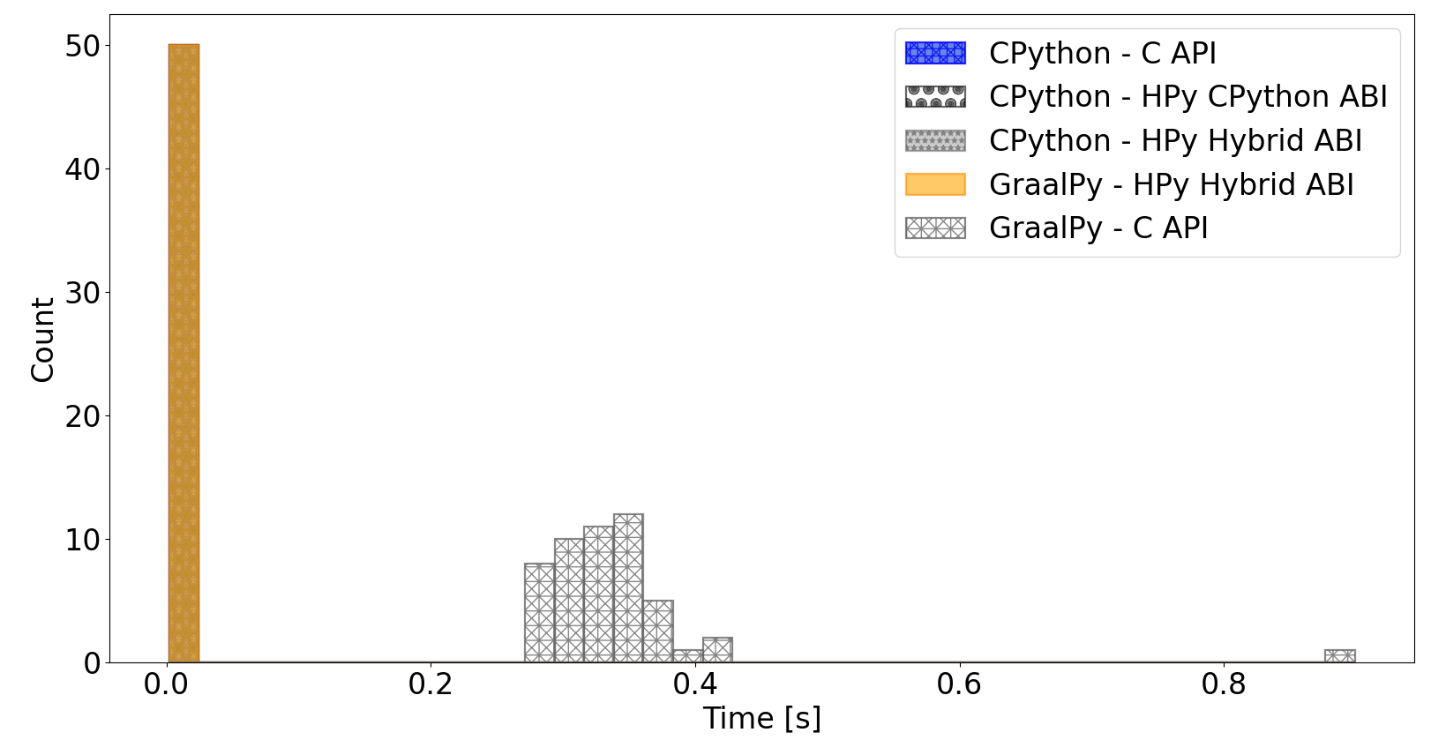
Forloop

Slide 20
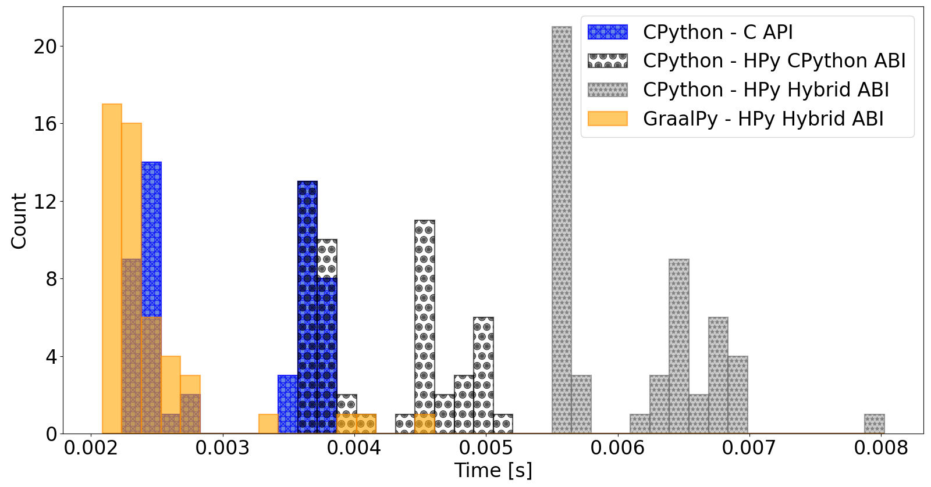
Forloop

Slide 21
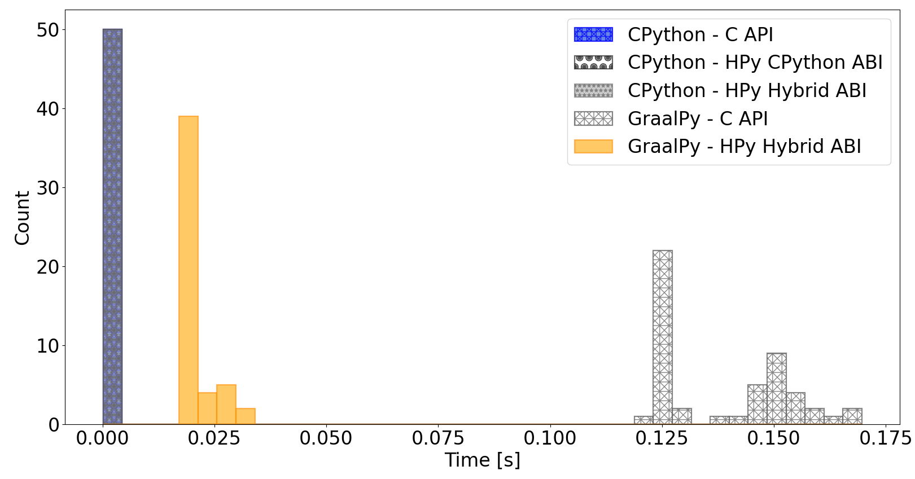
Fibonacci

Slide 22
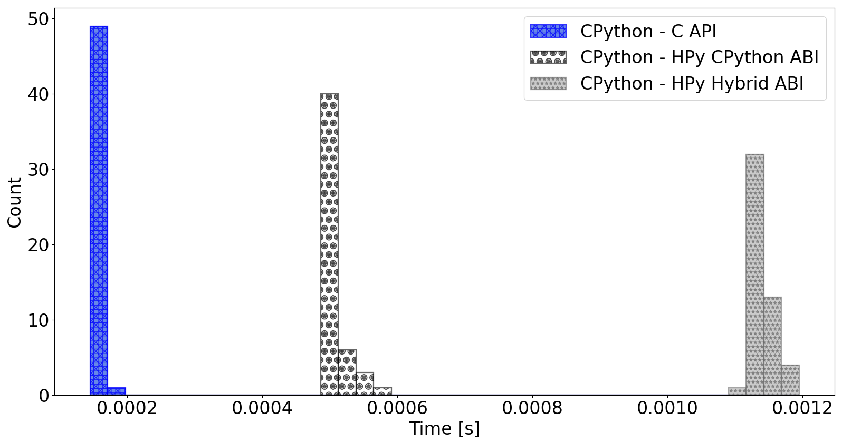
Fibonacci

Slide 23
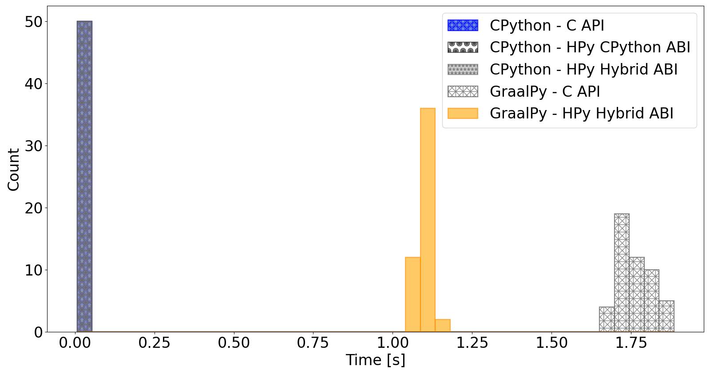
Float

Slide 24
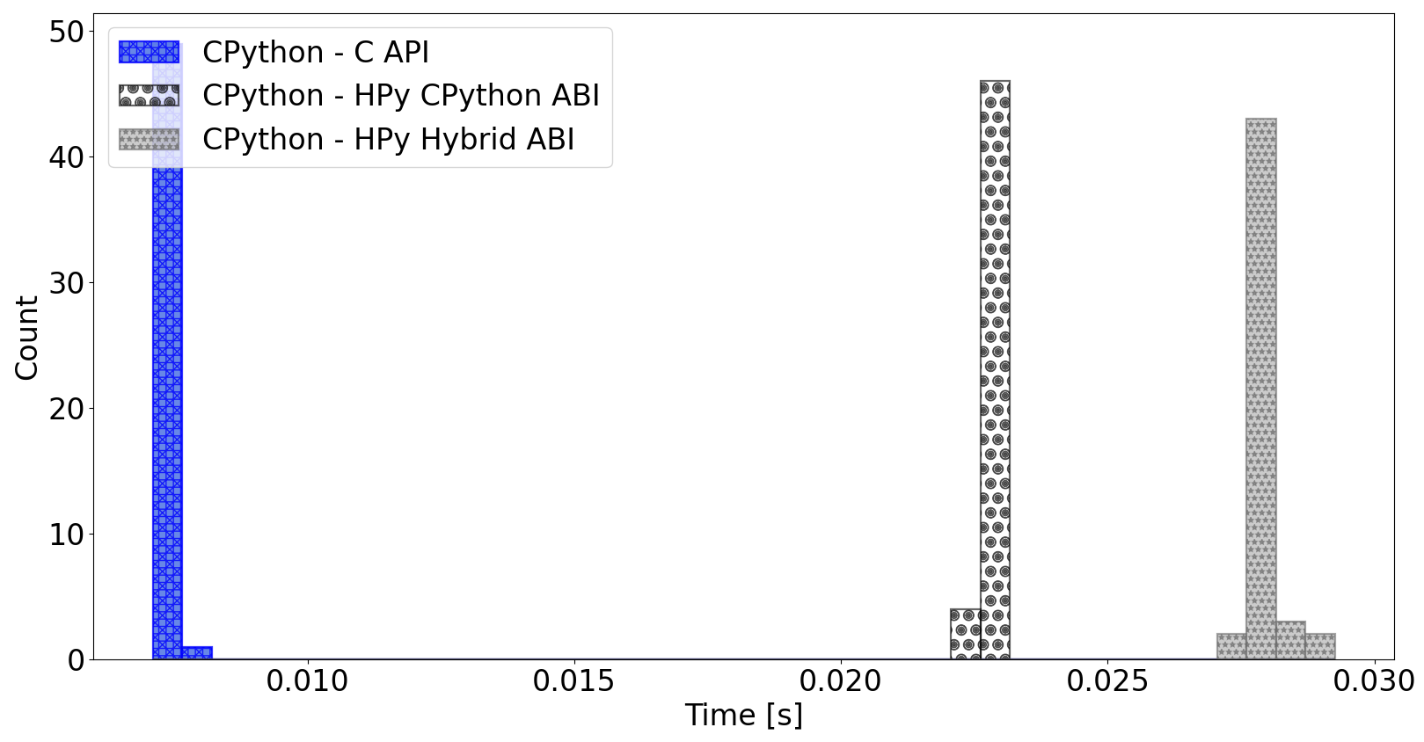
Float

Slide 25
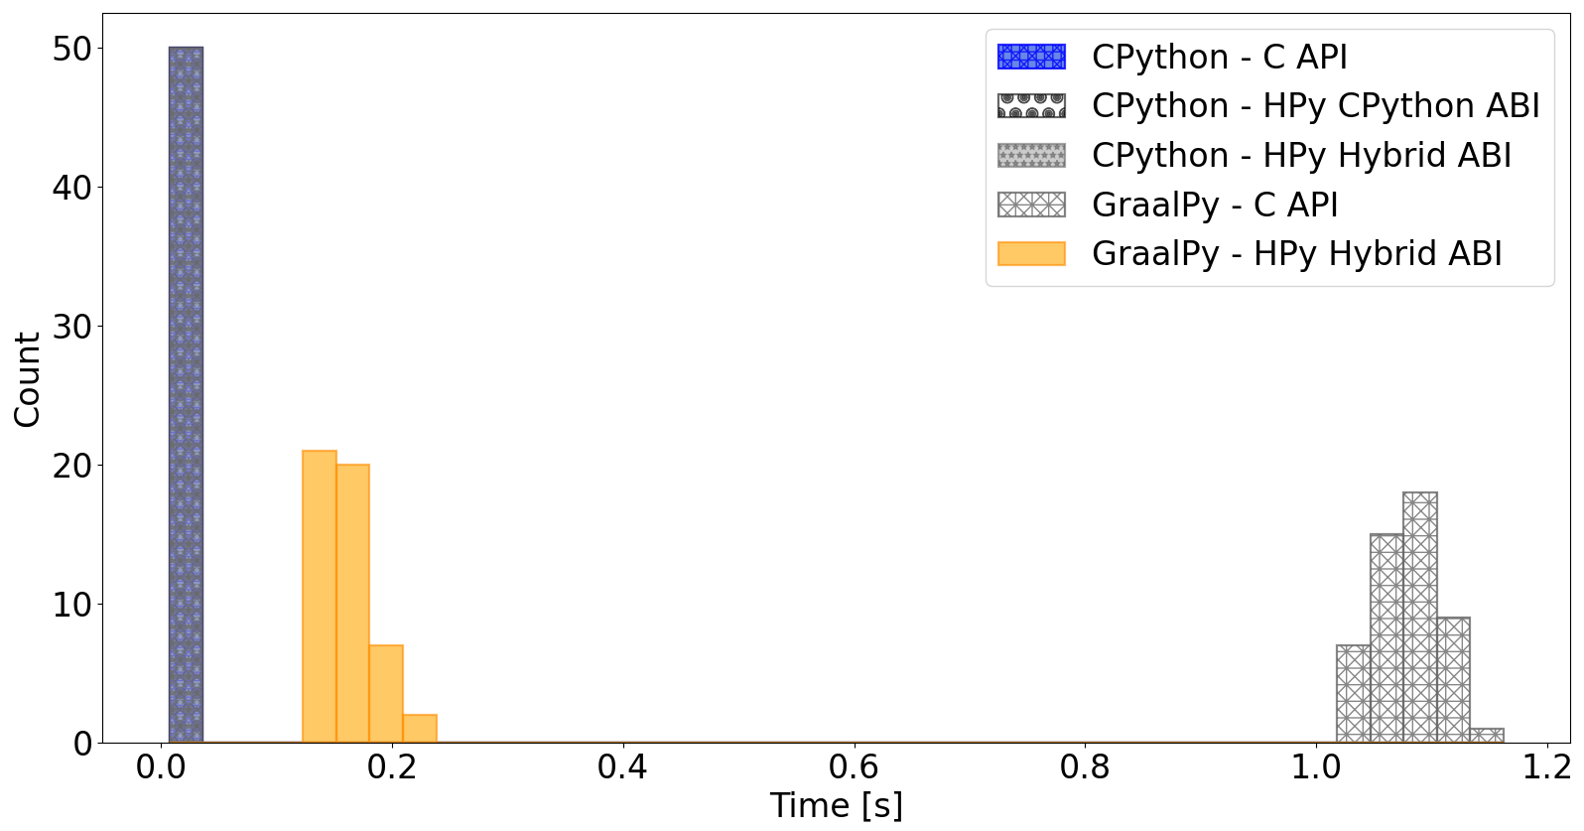
Fannkuch

Slide 26
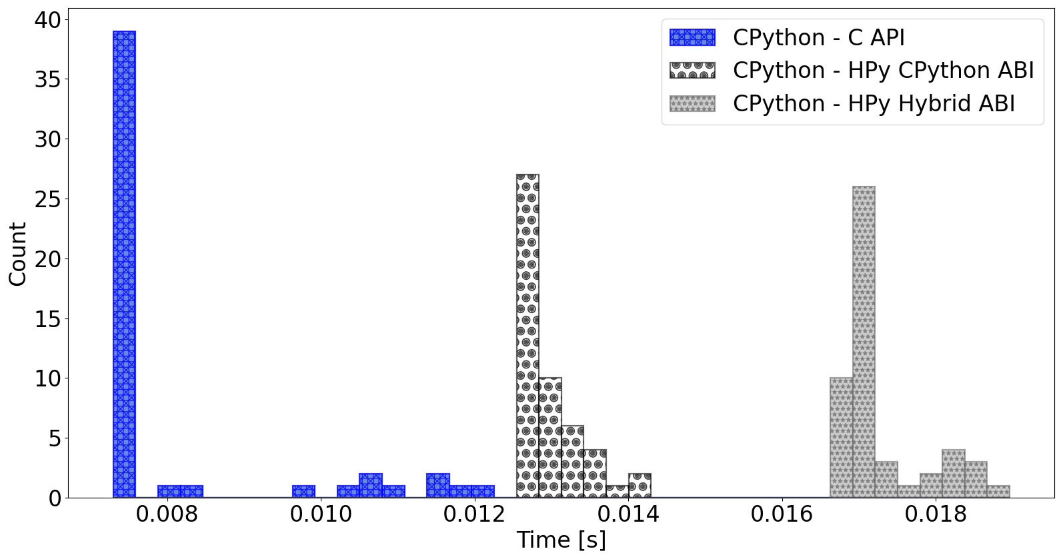
Fannkuch

Slide 27
Conclusions
HPy can improve Cython library performance on GraalPy
HPy on GraalPy can equal the C API on CPython
HPy does not meet performance expectations on CPython
HPy is worth pursuing – Cython’s C API optimisations are a special case
There’s still more work to do on the HPy backend for Cython

Slide 28
Acknowledgements
Professor Michelle Kuttel – supervisor
Oracle – Funding and Research Internship in Austria
If you want to know more, see my work at https://github.com/DuToitSpies/cython/tree/hpy_backend or contact me at dutoitspies@protonmail.com

Slide 29
Conclusions
HPy can improve Cython library performance on GraalPy
HPy on GraalPy can equal the C API on CPython
HPy does not meet performance expectations on CPython
HPy is worth pursuing – Cython’s C API optimisations are a special case
There’s still more work to do on the HPy backend for Cython

Slide 30
Conclusions
HPy can improve Cython library performance on GraalPy
HPy on GraalPy can equal the C API on CPython
HPy does not meet performance expectations on CPython
HPy is worth pursuing – Cython’s C API optimisations are a special case
There’s still more work to do on the HPy backend for Cython

